Slide 1
AVL Tree Session 15-16
Course : Data Structures
Effective Period : December 2018

Slide 2
Learning Outcomes
At the end of this session, students will be able to:
LO 1: Explain the concept of data structures and its usage in Computer Science
LO 2: Illustrate any learned data structure and its usage in application
LO 3: Apply data structures using C

Slide 3
Outline
Balanced Binary Search Tree
AVL Tree Concept
Operation: Search, Insertion
Rebalance AVL Tree (Insertion)
Operation: Deletion
Rebalance AVL Tree (Deletion)

Slide 4
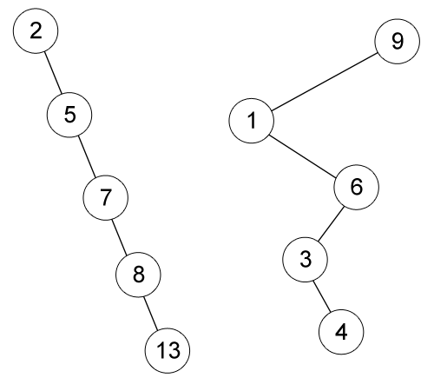
Binary Search Tree Review
Example of skewed Binary Search Tree
The left BST is inserted by 2, 5, 7, 8 and 13 respectively.
The right BST is inserted by 9, 1, 6, 3 and 4 respectively.

Slide 5
Balanced Binary Search Tree
The height of Binary Search Tree can be as large as n-1 (when the BST is skewed).
The time needed to perform insertion, deletion, searching or many other operations depend on the tree’s height, this means they can be O(n) in worst case.
So our goal is to keep the height of a BST to be O (log n), the minimal height of a BST with n nodes
Such trees are called Balanced Binary Search Tree (i.e. AVL Tree, Red Black Tree) because it will keep the minimal height of a BST

Slide 6
AVL Tree
AVL Tree is named after its two inventors, G.M. Adelson-Veleskii and E.M. Landis.
AVL Tree is the first self-balancing binary search tree invented.

Slide 7
AVL Tree
Height of a node:
The height of an empty subtree is 0.
The height of a leaf is 1.
The height of an internal node is the maximum height of its children plus 1.
Balance factor:
The difference height of its LEFT subtree and its RIGHT subtree.
The balance factor of all nodes in AVL tree should be at most 1.

Slide 8
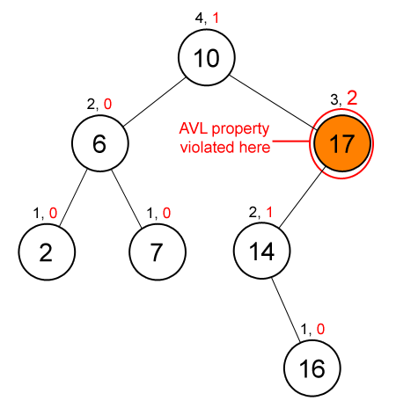
AVL Tree Example
Height Balance Factor
Balance Factor : Pengurangan Height kiri kanan
The node contains 17’ (orange color) balance factor is more than 1, so this BST is not an AVL Tree.

Slide 9
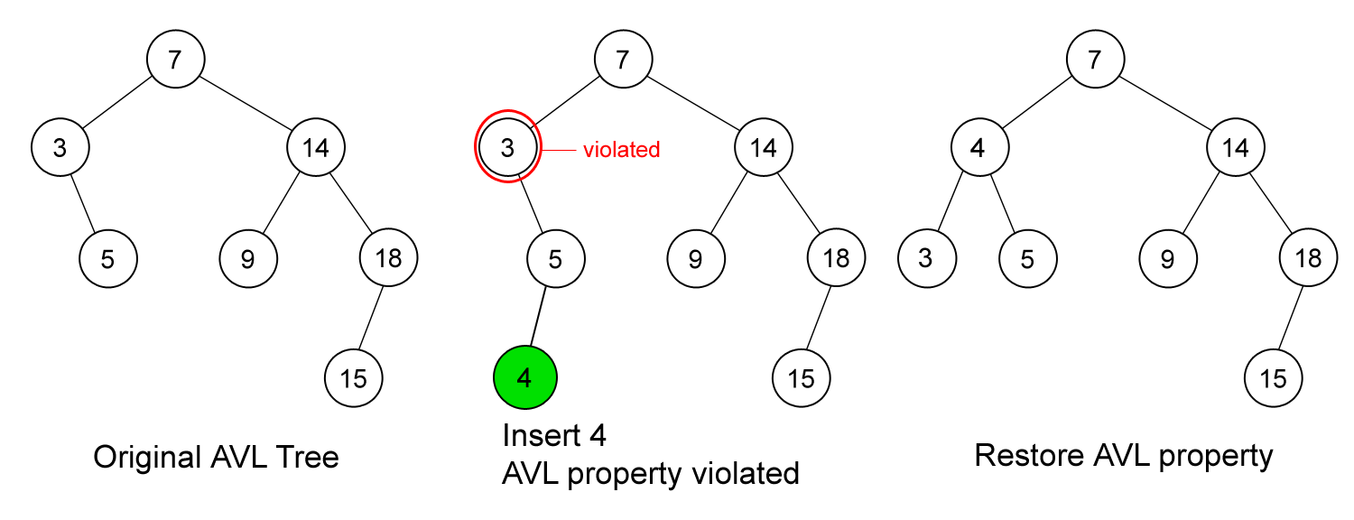
AVL Tree Operations: Insertion
First, insert the new key as a new leaf just as in ordinary Binary Search Tree insert strategy.
But this may cause violation of AVL Tree property.
Next, restore the balance condition.

Slide 10
Rebalance AVL Tree
After an insertion, only nodes that are on the path from the inserted node to the root that might violate the AVL property.
Why?
Rebalance the tree at the deepest level of such nodes guarantees that the property of AVL Tree restored.
Why?
How to rebalance a violated AVL Tree?

Slide 11
Rebalance AVL Tree
Let the node that must be rebalanced be T.
There is 4 cases:
Case 1 : the deepest node is located at the left sub tree of the left child of T.
Case 2 : the deepest node is located at the right sub tree of the right child of T.
Case 3 : the deepest node is located at the right sub tree of the left child of T.
Case 4 : the deepest node is located at the left sub tree of the right child of T.
Note: In insertion, the deepest node will be the inserted node.

Slide 12
Rebalance AVL Tree
Rebalance of AVL Tree done by rotation.
Violation on case 1 and 2 (left-left or right-right) are fixed by single rotation.
Violation on case 3 and 4 (left-right or right-left) are fixed by double rotation.

Slide 13
AVL Tree Operations: Insertion
First, insert the new key as a new leaf just as in ordinary Binary Search Tree insert strategy.
But this may cause violation of AVL Tree property.
Next, restore the balance condition. How?
Trace the path from the new key towards the root. For each node
P encountered, check if heights of left(P) and right(P) differ by at
most 1.
If Yes, proceed to parent(P).
If No, fix sub tree P either by single rotation or double rotation.

Slide 14
AVL Tree Operations: Insertion
LL rotation: the new node is inserted in the left sub-tree of the left sub-tree of the critical node
RR rotation: the new node is inserted in the right sub-tree of the right sub-tree of the critical node.
LR rotation: the new node is inserted in the right sub-tree of the left sub-tree of the critical node
RL rotation: the new node is inserted in the left sub-tree of the right sub-tree of the critical node

Slide 15
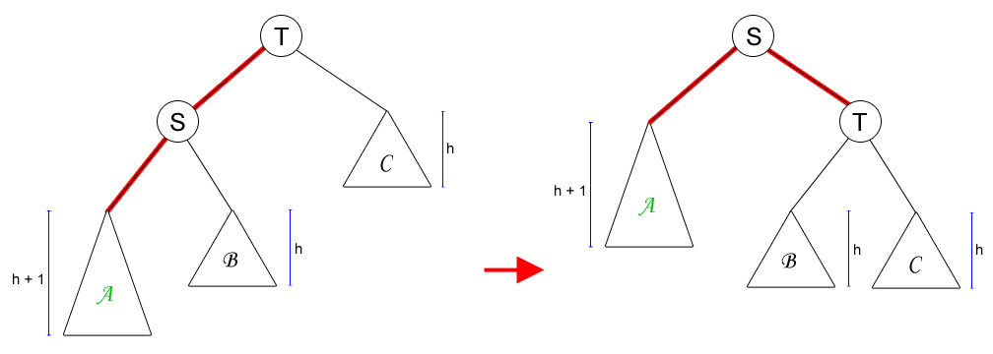
Single Rotation to Fix Case 1 (LL Rotation)
The new key is located at sub tree A.

Slide 16
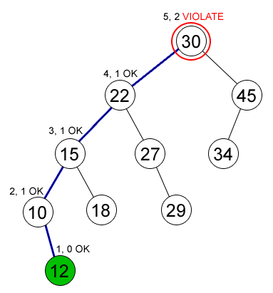
Example on Single Rotation
Node (12) is inserted in an AVL Tree and causing node (30) to violate the AVL property (Case 1)

Slide 17
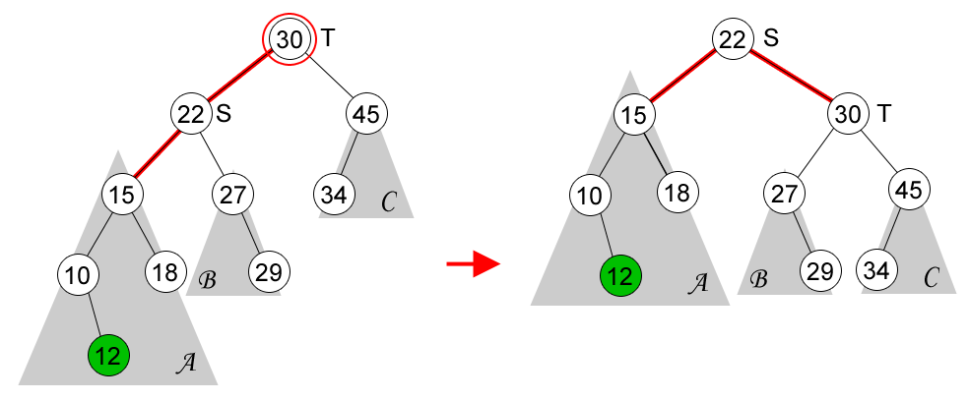
Example on Single Rotation

Slide 18
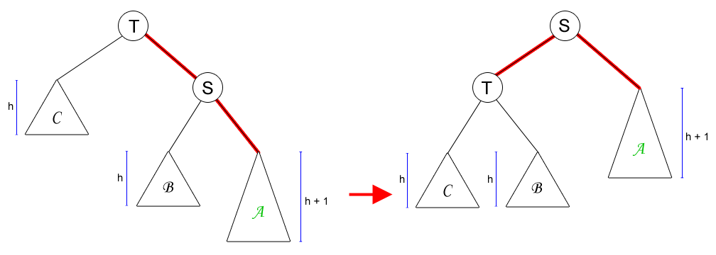
Single Rotation to Fix Case 2 (RR Rotation)
Case 2 is mirror symmetry to Case 1.

Slide 19
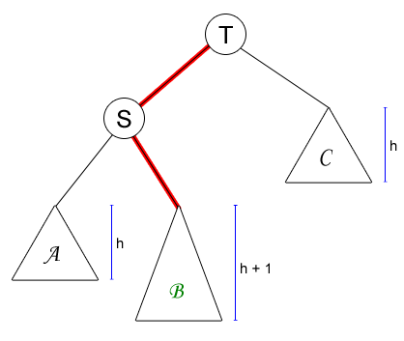
Single Rotation on Case 3 (or 4)
What will happen if we do single rotation on case 3 or 4?

Slide 20
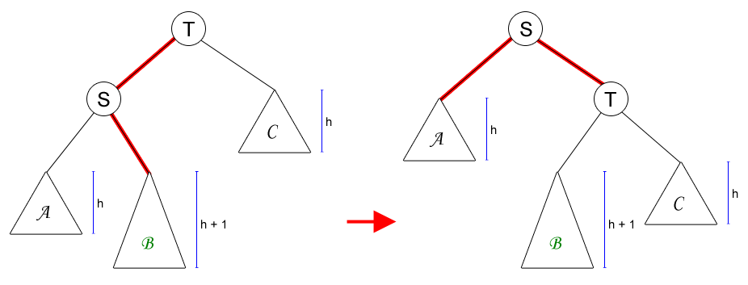
Single Rotation on Case 3 (or 4)
The AVL property is violated at node S (the height of its left-sub tree is h and the height of its right-sub tree’s is h+2).
Single rotation is not solving our problem on Case 3 or 4.

Slide 21
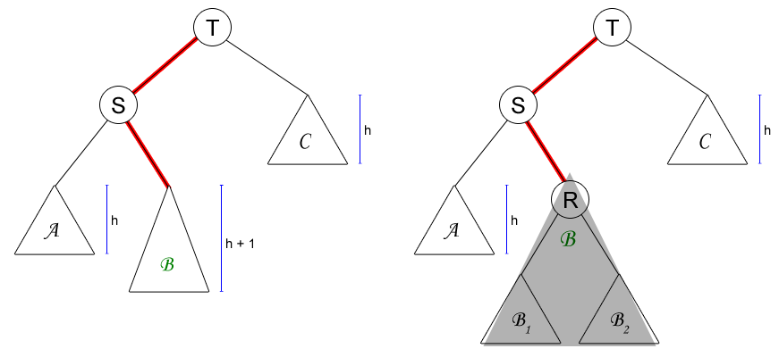
Double Rotation to Fix Case 3 (LR Rotation)
A deeper look at sub tree B

Slide 22
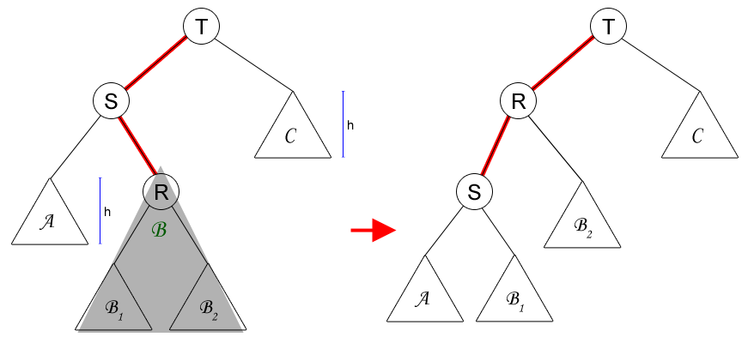
Double Rotation to Fix Case 3 (LR Rotation)
First rotation: node R and S.

Slide 23
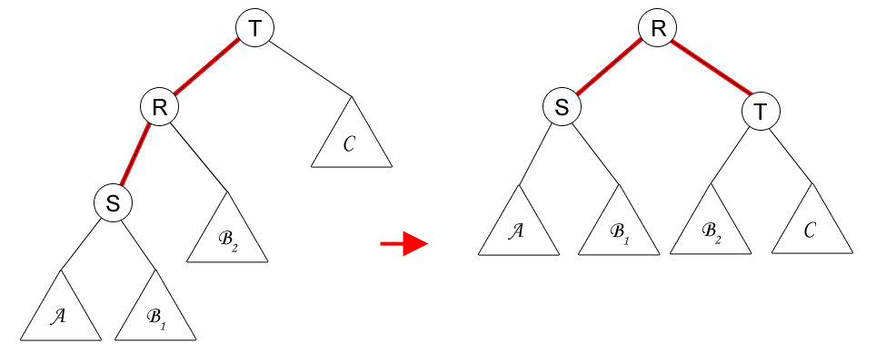
Double Rotation to Fix Case 3 (LR Rotation)
Second rotation: node R and T.

Slide 24
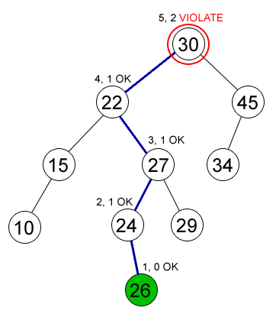
Example on Double Rotation
Node (26) is inserted in an AVL Tree and causing node (30) to violate the AVL property (Case 3)

Slide 25
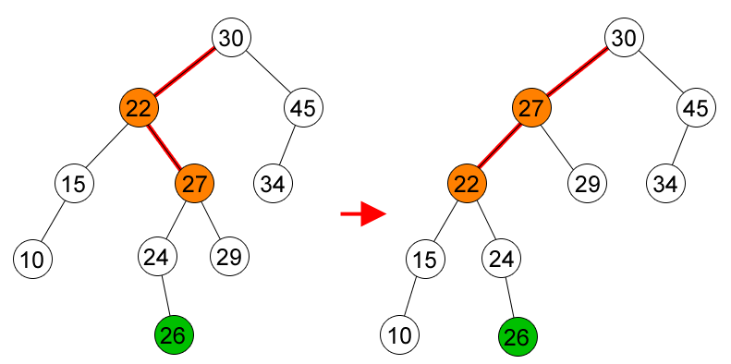
Example on Double Rotation
First rotation, node (27) and node (22).

Slide 26
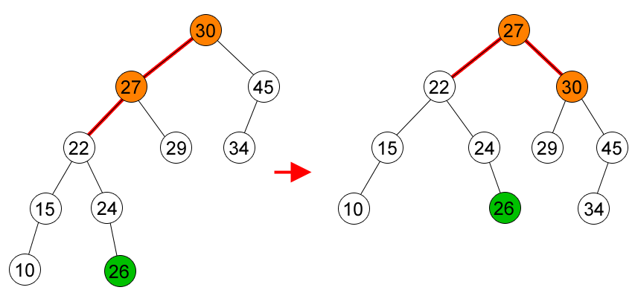
Example on Double Rotation
Second rotation, node (27) and node (30).

Slide 27
AVL Tree Operations: Deletion
Delete the node as in ordinary Binary Search Tree.
The deleted node will be a leaf or a node with one child.
Trace the path from the (parent of) deleted leaf towards the root. For each node P encountered, check if height of left(P) and right(P) differ by at most 1.
If Yes, proceed to parent(P).
If No, fix sub tree P either by single rotation or double rotation (as in insertion).
After we perform rotation at P, we may have to perform a rotation at some ancestor of P. Thus, we must continue to trace the path until we reach the root.

Slide 28
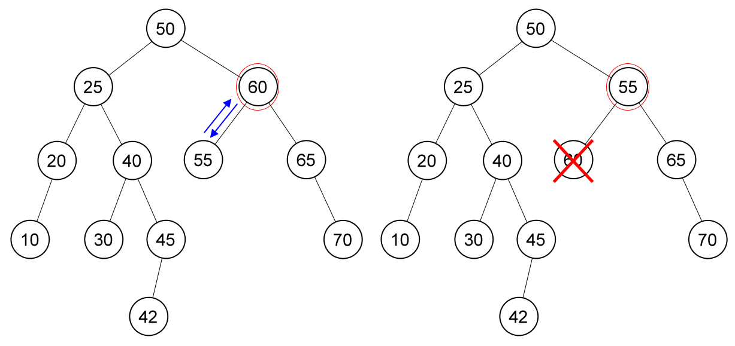
Example on Deletion
Delete node (60), node (55) is unbalanced.

Slide 29
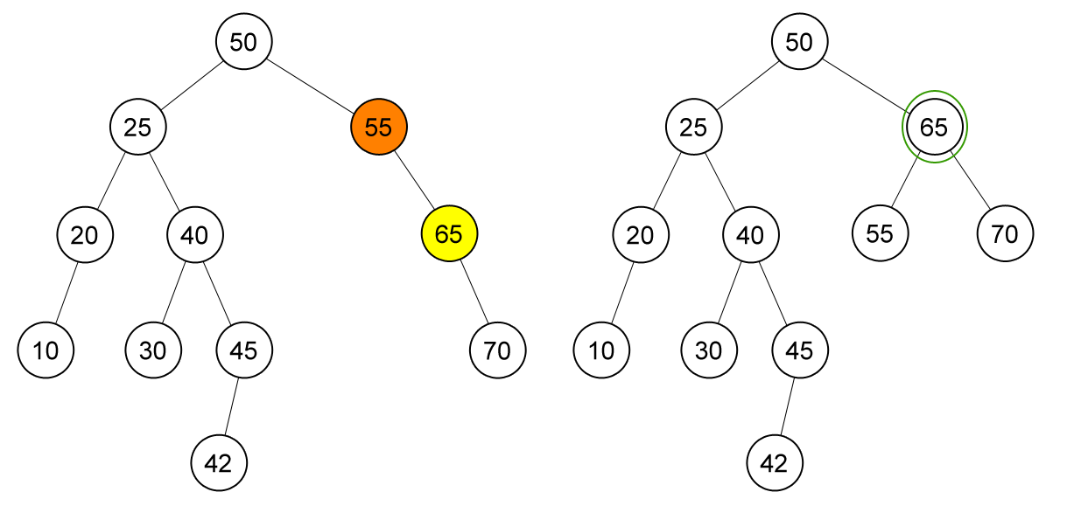
Example on Deletion
Single rotation on node (55)

Slide 30
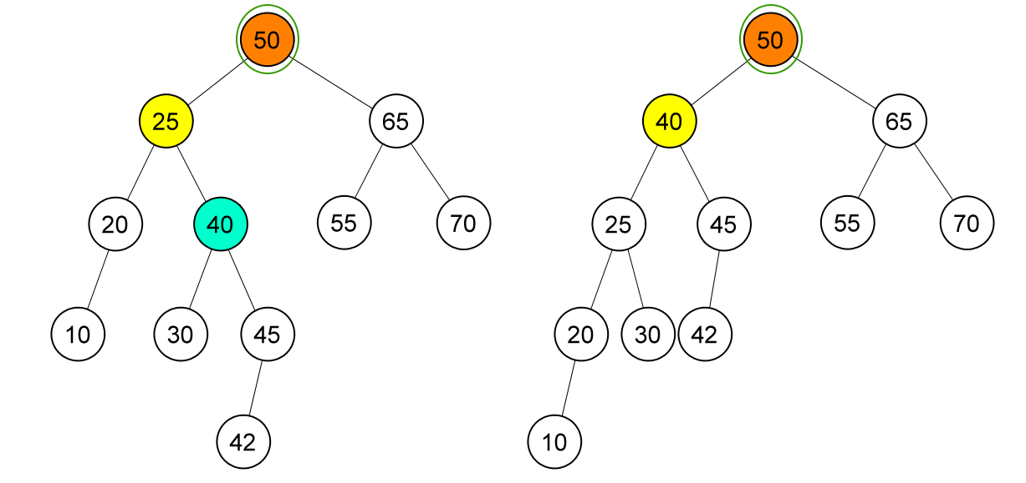
Example on Deletion
Node (50) is unbalanced, double rotation on node (50)

Slide 31
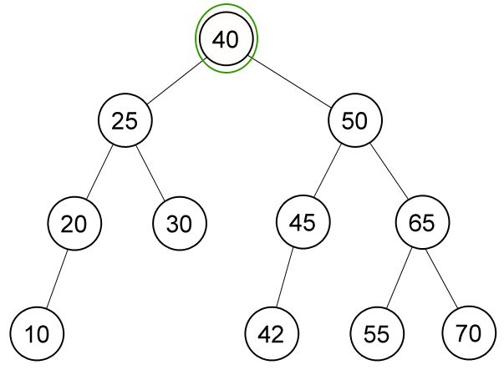
Example on Deletion
AVL Tree after deletion of node (60)

Slide 32
References
S. Sridhar. 2015. Design and Analysis of Algorithms. Oxford University Press. New Delhi. ISBN: 9780198093695. Chapter 6
Reema Thareja. 2014. Data structures using C. Oxford University Press. New Delhi. ISBN:9780198099307. Chapter 10
Introduction to AVL Tree, https://visualgo.net/bn/bst?slide=13-1
AVL Tree, https://visualgo.net/bn/bst?slide=14

